Slide 1
Debugging Ruby

Slide 2
Simple Ruby Code
Notes:
https://stackoverflow.com/questions/3955688/how-do-i-debug-ruby-scripts

Slide 3
ruby -r debug filename
set breakpoints
run by steps
catch exceptions
display stacktrace
display variables
evaluate expressions
Notes:
https://stackoverflow.com/questions/3955688/how-do-i-debug-ruby-scripts
https://www.tutorialspoint.com/ruby/ruby_debugger.htm

Slide 4
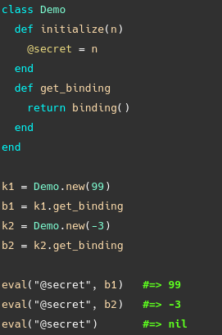
Binding
source && source_location
Objects of class Binding encapsulate the execution context at some particular place in the code and retain this context for future use. The variables, methods, value of self, and possibly an iterator block that can be accessed in this context are all retained. Binding objects can be created using Kernel#binding, and are made available to the callback of Kernel#set_trace_func.
irb(main):003:0> puts p.method(:activate).source
def activate
update(active: true)
end
irb(main):004:0> puts p.method(:activate).source_location
/home/berlin/projects/test/app/models/photo.rb
27

Slide 5
caller
exception.backtrace
Returns the current execution stack—an array containing strings in the form “file:line” or “file:line: in `method”‘. The optional start parameter determines the number of initial stack entries to omit from the result.
Returns any backtrace associated with the exception. The backtrace is an array of strings, each containing either “filename:lineNo: in `method''' or “filename:lineNo.''

Slide 6
II. Pry
Notes:
http://pryrepl.org/
https://github.com/pry/pry/wiki

Slide 7
show-method
show-doc
show-source
binding.pry && object.pry
ls, cd, edit, play
find-method
Notes:
https://medium.com/@jrmair/dig-deeper-with-pry-introducing-cruby-source-browsing-702cb8358690
https://shbrt.co/2018/02/22/see-ruby-source.html
https://medium.com/@tiagoparreira/powering-your-ruby-rails-development-with-pry-3d5dbd2a8b80

Slide 8
class Object def pry(object=nil, hash={})
if object.nil? || Hash === object
Pry.start(self, object || {})
else
Pry.start(object, hash)
end
end end
# Start a Pry REPL on self.
#
# If `self` is a Binding then that will be used to evaluate expressions;
# otherwise a new binding will be created.
Notes:
https://medium.com/@jrmair/dig-deeper-with-pry-introducing-cruby-source-browsing-702cb8358690
https://shbrt.co/2018/02/22/see-ruby-source.html
https://medium.com/@tiagoparreira/powering-your-ruby-rails-development-with-pry-3d5dbd2a8b80

Slide 9
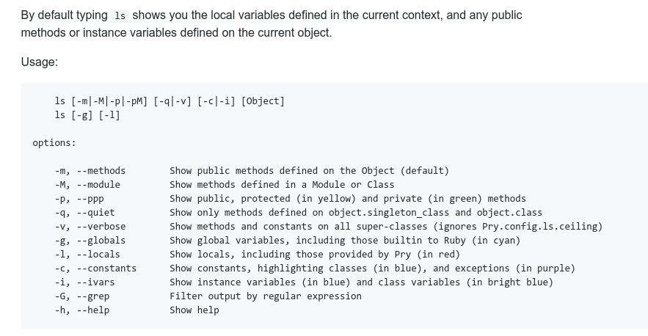
Notes:
https://medium.com/@jrmair/dig-deeper-with-pry-introducing-cruby-source-browsing-702cb8358690
https://shbrt.co/2018/02/22/see-ruby-source.html

Slide 10
III. Rails

Slide 11
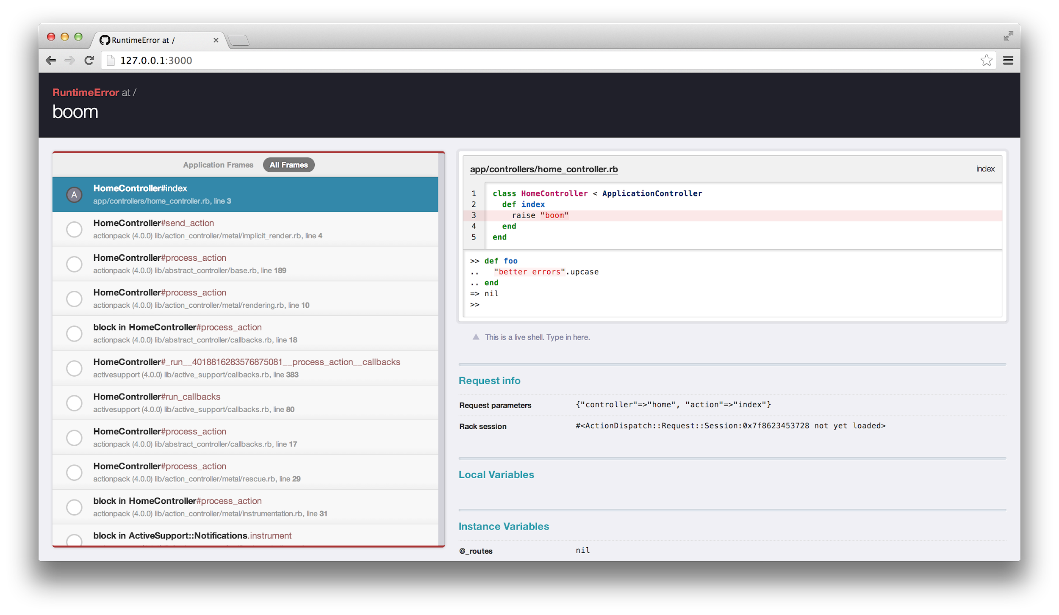
better_errors + binding_of_caller / byebug
Full stack trace
Source code inspection for all stack frames (with highlighting)
Local and instance variable inspection
Live shell (REPL) on every stack frame
Links directly to the source line in your editor
Useful information in non-HTML requests

Slide 12
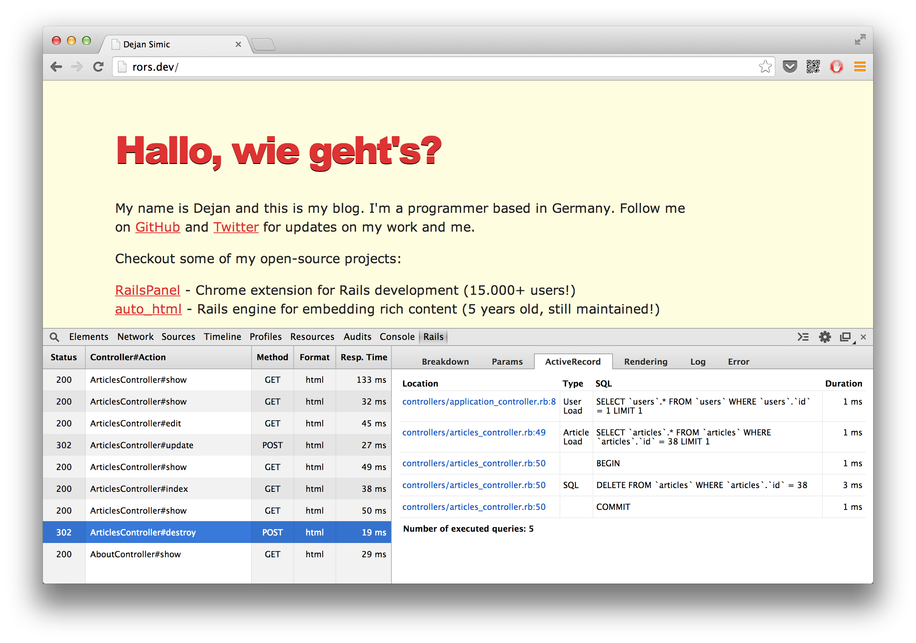
rails_panel

Slide 13


IV. Editors

Slide 14
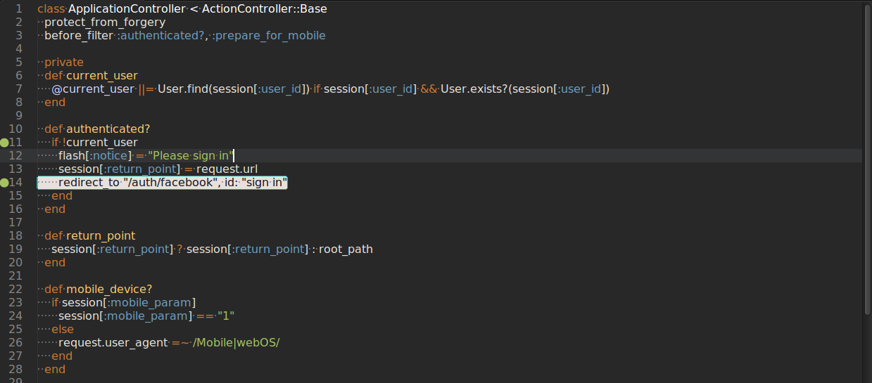
Sublime Text + Ruby Debugger

Slide 15
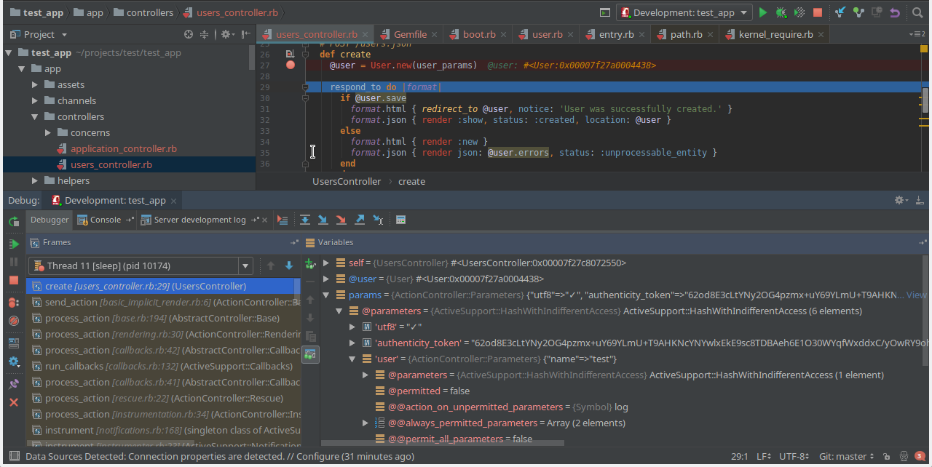
RubyMine

Slide 16
V. Further readings
http://valgrind.org/ - application for detecting C-based memory leaks and race conditions.
Query Reviewer - This Rails plugin not only runs "EXPLAIN" before each of your select queries in development, but provides a small DIV in the rendered output of each page with the summary of warnings for each query that it analyzed.
MethodProfiler - MethodProfiler collects performance information about the methods in your objects and creates reports to help you identify slow methods. The collected data can be sorted in various ways, converted into an array, or pretty printed as a table.

Slide 17
Links
https://stackoverflow.com/questions/3955688/how-do-i-debug-ruby-scripts
https://www.tutorialspoint.com/ruby/ruby_debugger.htm
http://guides.rubyonrails.org/debugging_rails_applications.html
http://pryrepl.org/
https://github.com/pry/pry/wiki
https://medium.com/@jrmair/dig-deeper-with-pry-introducing-cruby-source-browsing-702cb8358690
https://shbrt.co/2018/02/22/see-ruby-source.html
https://medium.com/@jrmair/dig-deeper-with-pry-introducing-cruby-source-browsing-702cb8358690
https://medium.com/@tiagoparreira/powering-your-ruby-rails-development-with-pry-3d5dbd2a8b80

